Slide 1
Arduino mini-project topic: SENSOR STATION: MEASURING AIR QUALITY INDEX
Made by:
Ishani sharma(2101ai16) pragya harsh(2101ai23)

Slide 2
ABOUT PROJECT
It is now important to monitor air pollution in real time in most of the urban areas.
This project is aimed at developing an IOT device which can monitor air pollution in real time and log data to a remote server. Remote monitoring was facilitated using classical modes in the past, which has some pitfalls like limited memory, processing speed and complex programming strategies. By using Internet of Things and recording sensor data to a remote server, the limitations of memory in the monitoring devices and manual collection of data from the installed devices can be overcome. The IOT also helps monitoring the data in real time

Slide 3
BRIEF DESCRIPTION OF THE PROJECT
In our project, we have tried to build a model that could help in monitoring one of the air pollution.
The air pollution monitoring device developed in this project is based on Arduino UNO, which connects to the ThingSpeak Website using the Wi-Fi Module. The sensor used for monitoring air pollution is the MQ-135 gas sensor. We have also integrated a DHT11 Temperature and Humidity Sensor. The sensor data ,is displayed on the serial monitor of the Arduino IDE application interfaced with the monitoring IoT device and plotted using the ThingSpeak App.

Slide 4
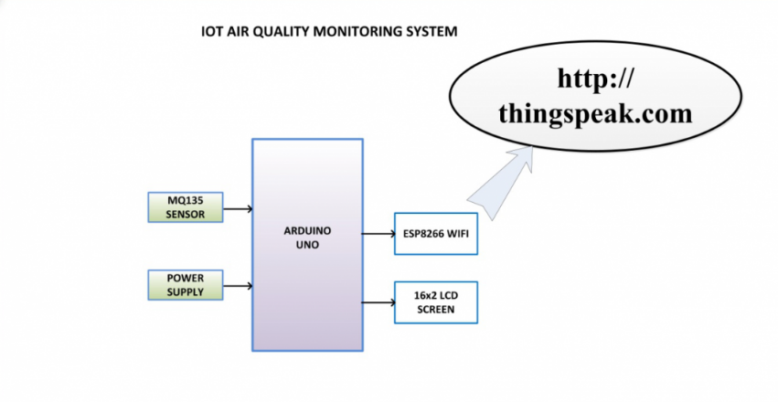
WORKING FLOW
ARDUINO IDE

Slide 5


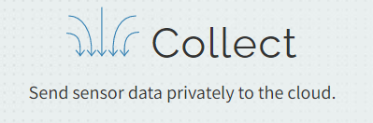
Components required:
Arduino UNO
NodeMCU ESP8266 Wifi-Module
MQ-135 Gas Sensor
DHT-11 Temperature and Humidity Sensor
Breadboard
Jumper wires
applications used:
Arduino IDE
ThingSpeak Website
Mobile App to plot the data

Slide 6
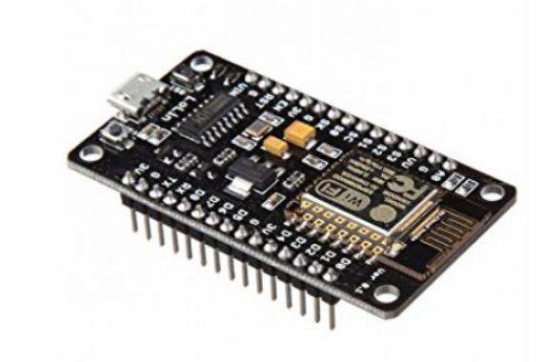
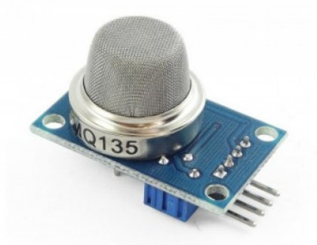
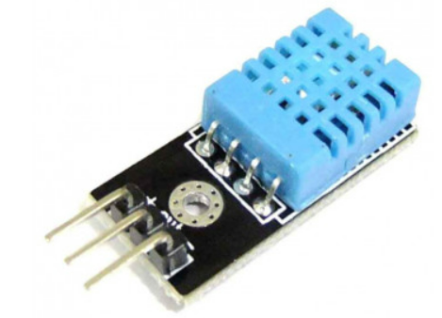
NodeMCU ESP8266 Wifi-Module
MQ-135 Gas Sensor
DHT-11 Temperature and Humidity Sensor

Slide 7
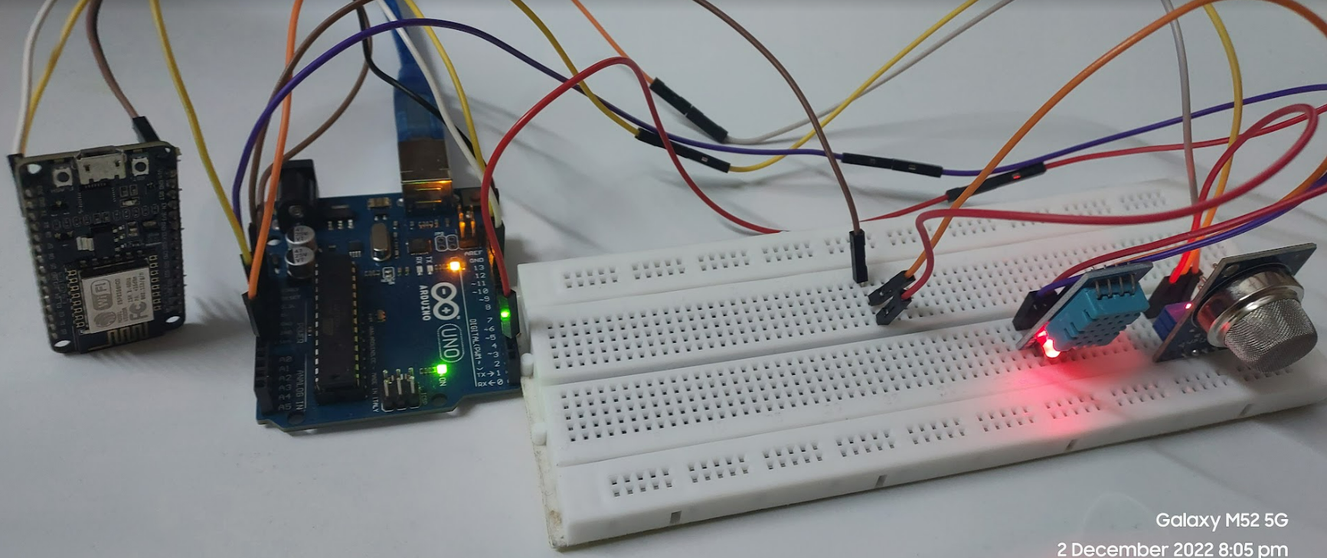
Picture of actual circuit

Slide 8
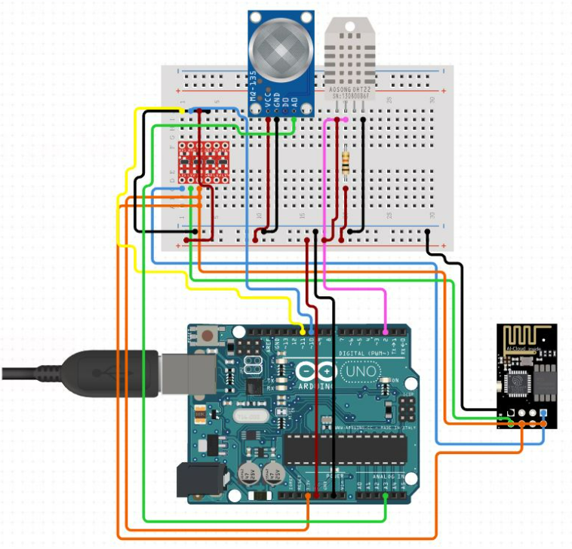
CIRCUIT DIAGRAM

Slide 9
Connection description
NodeMCU Esp8266
TX - 10
RX - 11
Vin - 5v
Gnd - gnd
DHT11
Vcc - 3.3v
Data - 2
Gnd - gnd
MQ135
A0 - A0
Vcc - 3.3v
Gnd – gnd

Slide 10
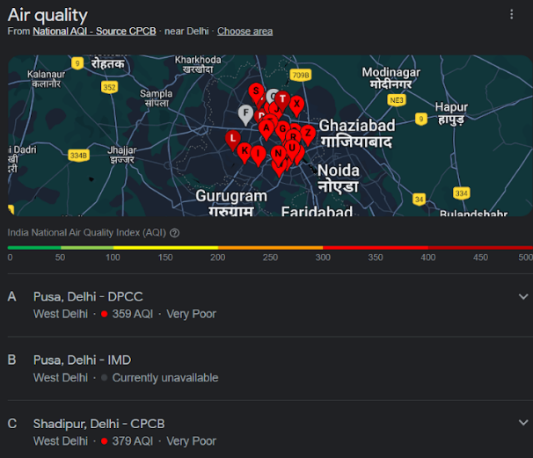
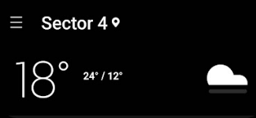

Test data set:
Location: South-West Delhi
Date: 1st December 2022
Time: 9 pm

Slide 11
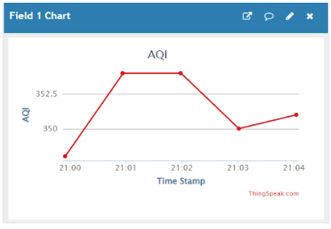
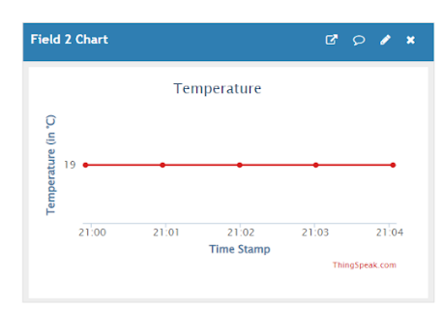
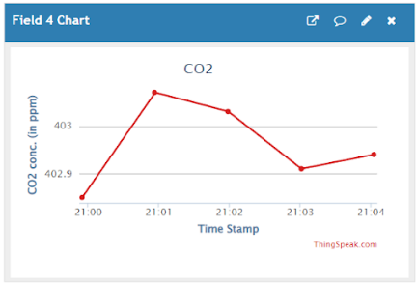
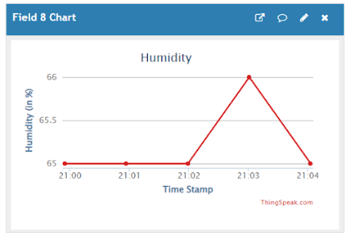
Plots obtained for the test data on thingspeak website

Slide 12
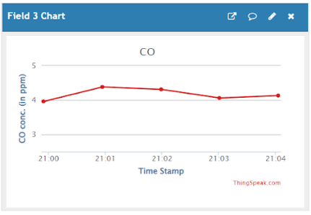
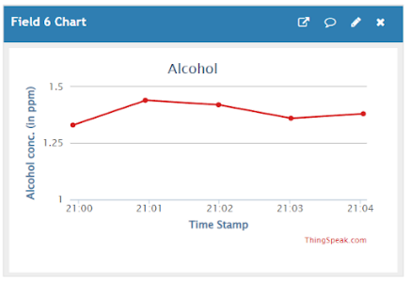
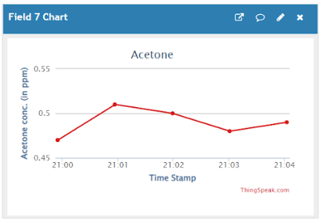
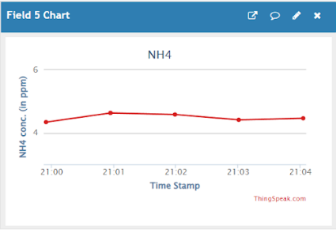

Slide 13
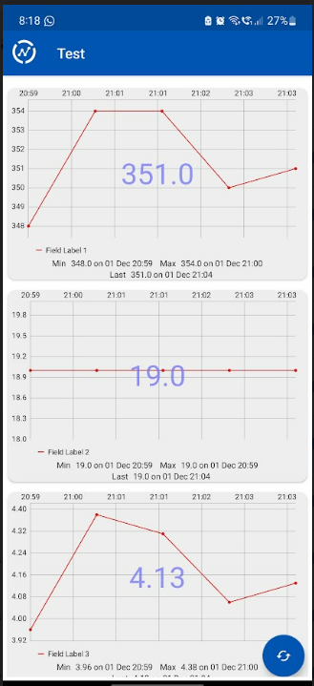
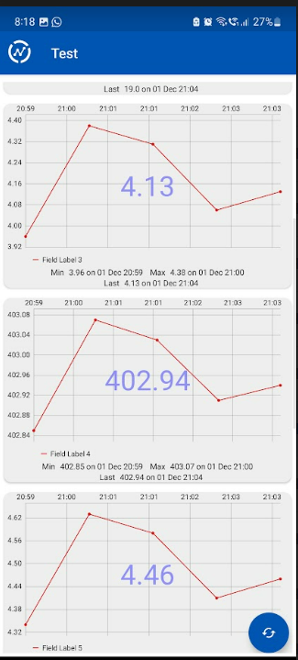
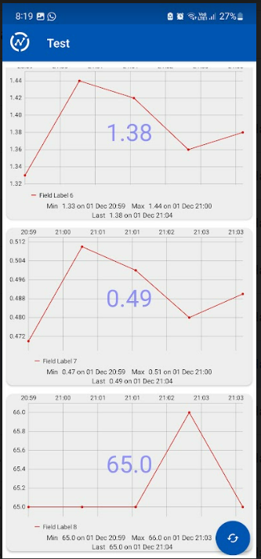
Mobile App view of the plots

Slide 14
THANK YOU

